Slide 1
Manuals for compiling the GPU code to generate the dll file
Prerequisites
Install visual studio (suggest vs2017 or newest versions ）
Install CUDA toolkit (we used CUDA 12.1)
Description of the CUDA codes
gpufit2D: CUDA code for fitting the sum image of SiLM to 2D Gaussian function to get the center lateral positions
gpurepeatfit2D: CUDA code for repeat fitting of the sub images in SiLM to get the intensities in sub images
gpusaimfitzrange: CUDA codes to get the z positions in SiLM within the predeifined axial range

Slide 2
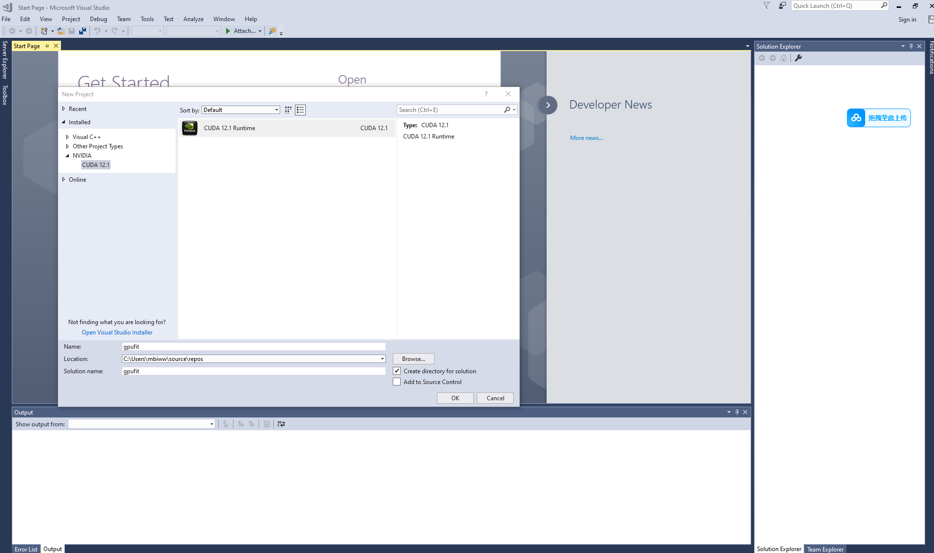
Step 1. Create a new CUDA project from visual studio

Slide 3
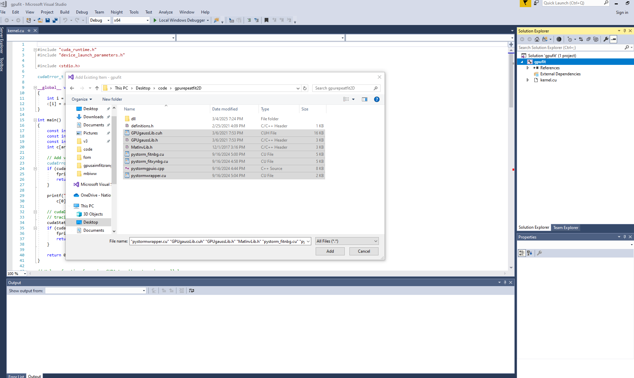
Step 2. Add the gpu codes to the project

Slide 4
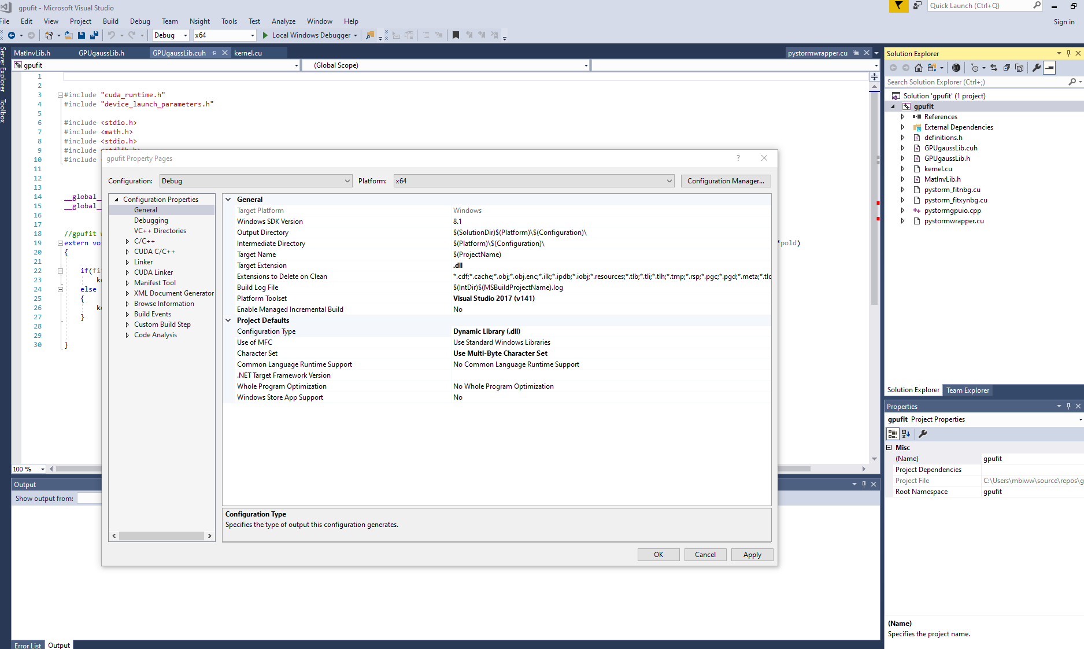
Step 3. Configure the target name and configuration type to dll

Slide 5
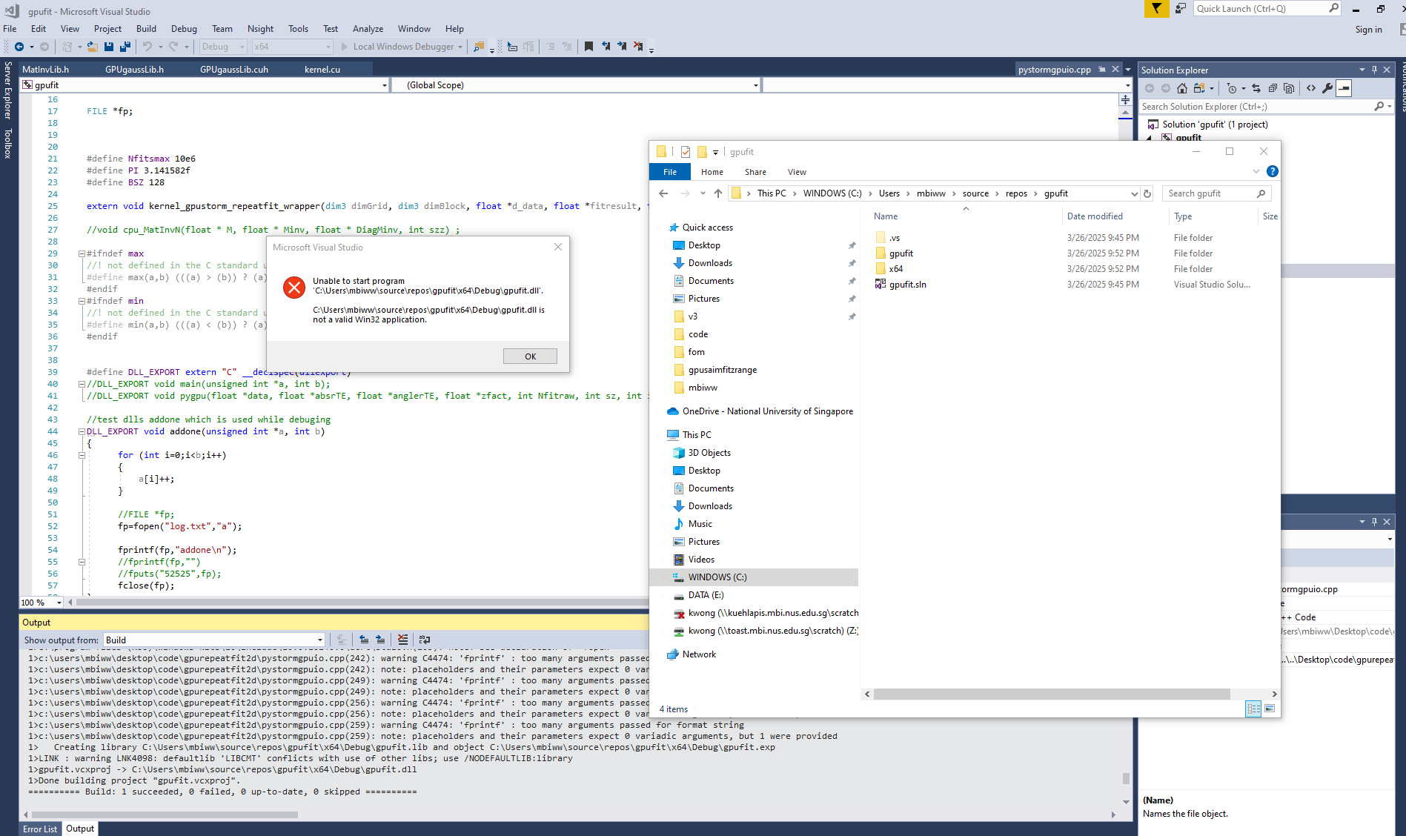
Step4. Run the code, and copy the generated dll file to the folder where you want to run the python script, generated dll file is under x64 folder

